Slide 1

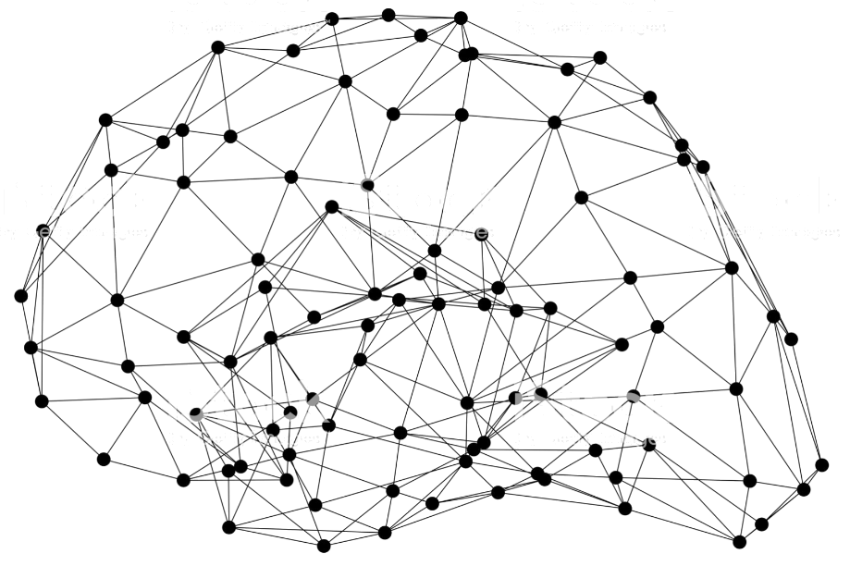
Image Classification using GluonCV
Notes:
First call deck for a high level introduction to Apache MXNet.

Slide 2
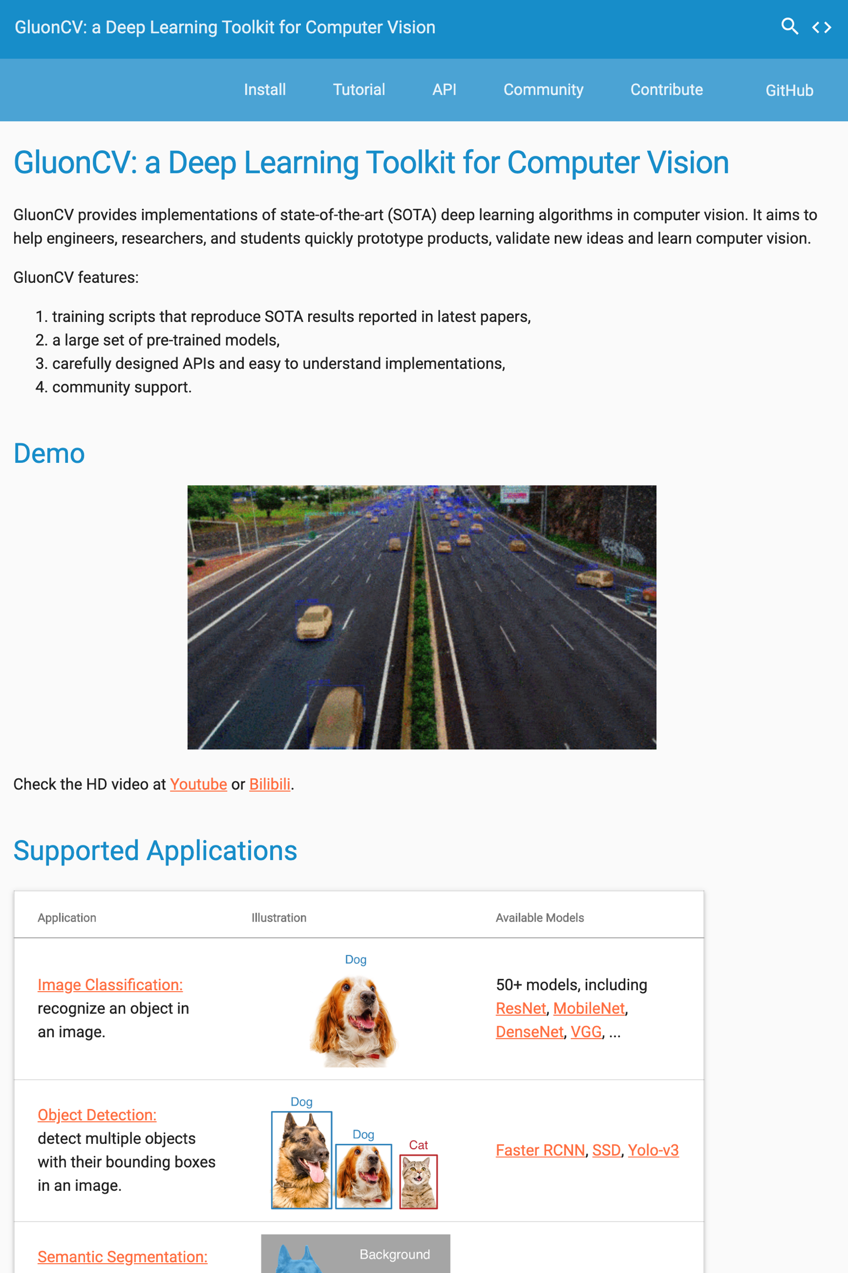
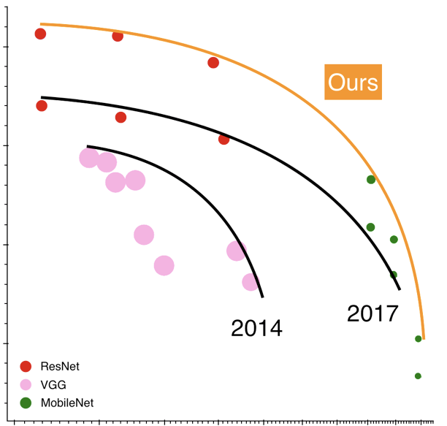
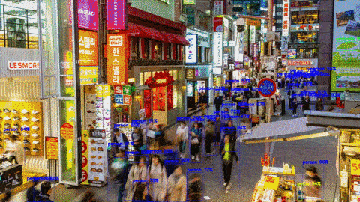
Image Classification
Model | Ours | Reference
ResNet-50 | 79.2% | 76.2%
ResNet-101 | 80.5% | 77.4%
MobileNet | 73.3% | 70.9%
MobileNetv3 | 75.3% | 75.2%
https://gluon-cv.mxnet.io/
https://gluon-cv.mxnet.io/model_zoo/classification.html
Notes:
Before I dive in to the GluonCV implementations for the state of the art models, please take a note that all the materials are always open sourced and tutorials are available on the website. You are welcome to check out the models and pretrained weights on the website because we will regularly update the latest models. For example, in this table we always provide the better than reference pretrained models. For mobilenet v3, AFAIK, we are the first to provide pretrained models and fully reproducible hyper-parameters.

Slide 3
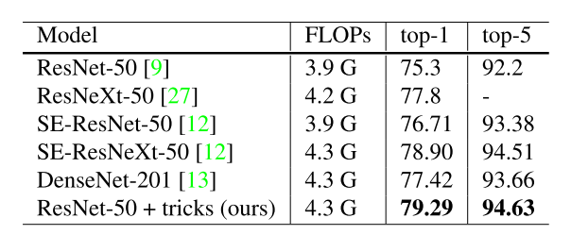
Bag of Tricks for Image Classification with Convolutional Neural Networks
- GluonCV original implementation
[1] Tong He, Zhi Zhang, Hang Zhang, Zhongyue Zhang, Junyuan Xie, Mu Li. CVPR 2019
Notes:
In this section, I will start with the most fundamental but very important topic: image classification, which is the foundation of so many computer vision tasks. I will also go through some of the details that help boosting the accuracy of the most widely used Image classification models.

Slide 4
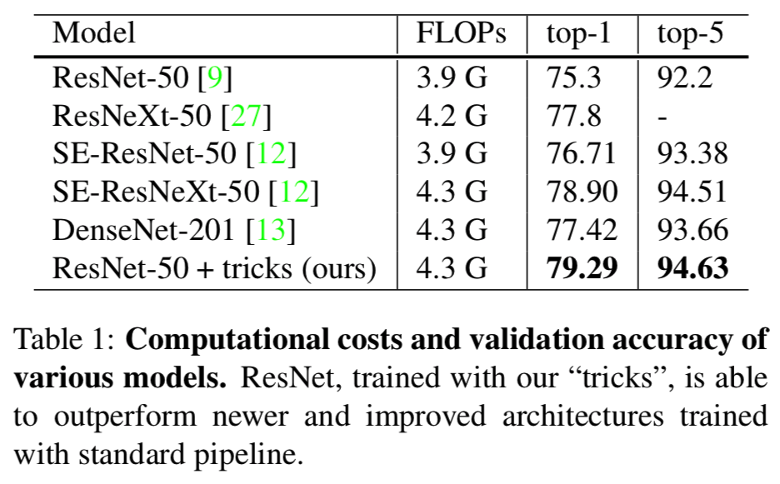
Unlike architectural advancements, training procedure and refinements - such as changes in loss functions, data preprocessing, optimization methods - received relatively less attention.
In this paper, a collection of training procedure and model architecture refinements that improve model accuracy will be examined.
Notes:
We focus on the training details, which … <continue on screen>
Let’s take a look at the table here. I have highlighted the results, and you can notice here that training procedure and minor tweaks of the network can improve the most widely used renset50 to 79% accuracy, outperforms newer architectures without these modifications.

Slide 5
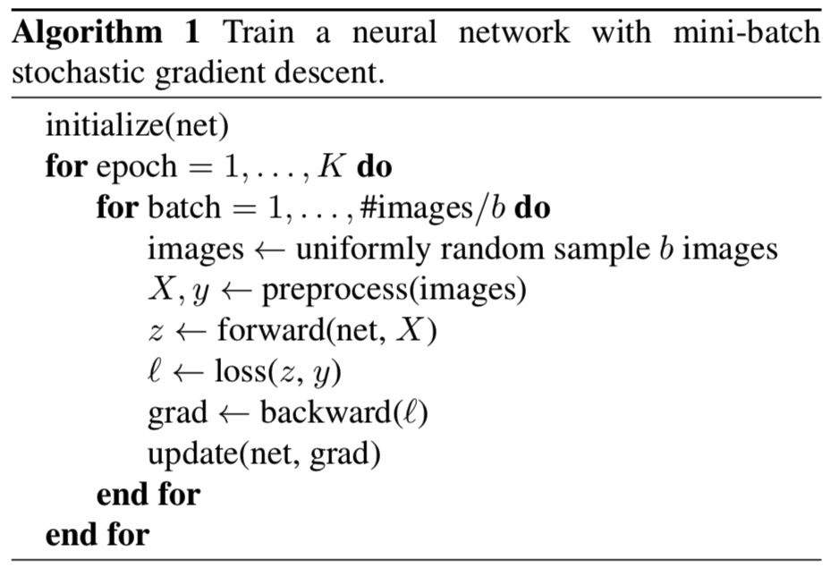
Training Procedures
Notes:
This is the pseudo code of a typical training loop…

Slide 6
2.1 Baseline Training Procedure
Baseline architecture: ResNet-50
Preprocessing pipeline
Randomly sample an image and decode it into 32-bit floating point raw pixel values in [0, 255].
Randomly crop a rectangular region whose aspect ratio is randomly sampled in [3/4, 4/3] and area randomly sampled in [8%, 100%], then resize the cropped region into a 224-by-224 square image.
Flip horizontally with 0.5 probability.
Scale hue, saturation, and brightness with coefficients uniformly drawn from [0.6, 1.4].
Add PCA noise with a coefficient sampled from a normal distribution N(0, 0.1).
Normalize RGB channels by subtracting 123.68, 116.779, 103.939 and dividing by 58.393, 57.12, 57.375, respectively.
Notes:
To make a fair comparison, we first provide a baseline benchmark with the following settings. This is the standard setup that was commonly used to train models on imagenet.

Slide 7
2.1 Baseline Training Procedure
Weights initialization: Xavier algorithm
Bias initialization: all zeros
Batch Normalization layers: (γ, β) = (1, 0)
Optimizer: Nesterov Accelerated Gradient (NAG)
Each model trained for 120 epochs, 8 V100 GPUs, batch size of 256.
Learning rate: initialized to 0.1, divided by 10 at the 30th, 60th, and 90th epochs.

Slide 8
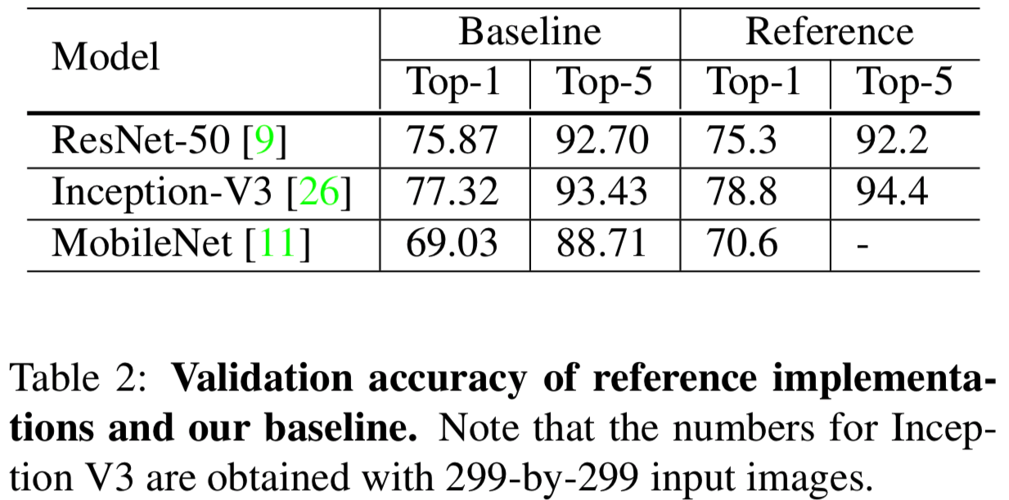
2.2 Baseline Results
Notes:
The results provided here is generated using the baseline settings. We can see that except that resnet 50 is slightly better the results claimed in paper, the rest of the models are worse than the number reported in their papers.

Slide 9
3. Efficient Training using GluonCV
Notes:
Now we will start explaining the training procedures using GluonCV

Slide 10
3.1 Large-batch Training
Linear scaling learning rate
Learning rate warmup
Zero gamma
No bias decay
3.2 Low-precision Training
3.3 Experimental Results

Slide 11
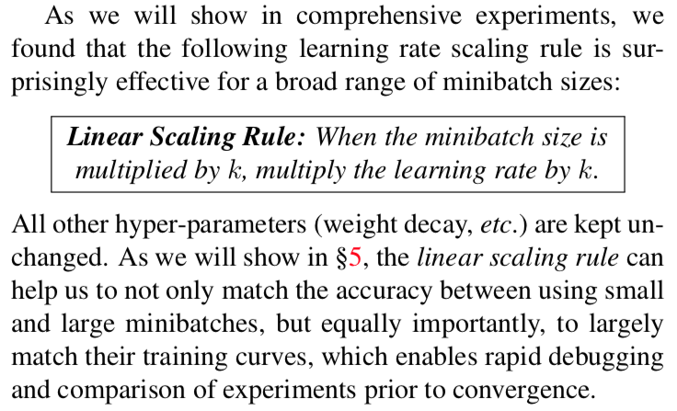
3.1 Large-batch Training Linear scaling learning rate
Goyal et.al., “Accurate, Large Minibatch SGD: Training ImageNet in 1 Hour”
https://arxiv.org/pdf/1706.02677.pdf
Notes:
Accurate, large minibatch SGD: training imagenet in 1 hour 논문에 따르면 batch size를 키워주면, 그 만큼 linear하게 learning rate를 키워주는 것이 좋다고 언급하고 있습니다. 이러한 방식을 본 논문에서도 실험을 해보았습니다. 즉 batch size=256, initial learning rate=0.1일 때, 만약 batch size를 b 로 키워주면 initial learning rate도 0.1 * b/256 으로 키워주는 것을 의미합니다.
Linear scaling learning rate: When training a Neural Network, we feed the images into our GPU in batches, as the memory permits. These are drawn by random in SGD and have some variance to them. As we increase the batch size, our batch to batch variance of images reduces, this allows more aggressive learning rate settings. Learning rate is set using the formula: 0.1 x (Batch_size)/256

Slide 12
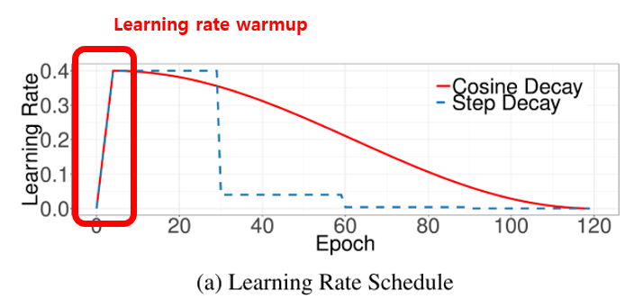
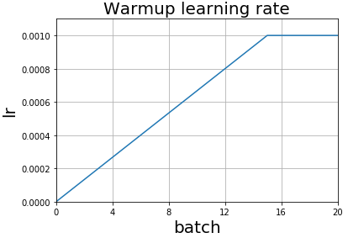
Learning rate warmup
Goyal et.al., “Accurate, Large Minibatch SGD: Training ImageNet in 1 Hour”
https://arxiv.org/pdf/1706.02677.pdf
Notes:
Learning Rate Warmup: When we train a Neural Net, we set the Learning Rate which determines how “fast” does the model learn or how aggressively do we penalize the predictions from it. As we start training our Neural Network, we can expect the weights to have more randomness. If we set an aggressive learning rate, that might cause the network to diverge. To fix this, Learning rate warmup is used which allows the learning rate to be set to lower values initially and later increased. This is done as follows: initially learning rate is set to ~0 and then increased for the “initial batches” as per the formula: Current epoch* (Learning Rate)/(Num_of_Initial_Epochs) Num of initial epochs: is a hyperparameter, the number that we choose to keep until the model is “warmed up” Learning Rate: Our final learning rate that we set for the NN.

Slide 13
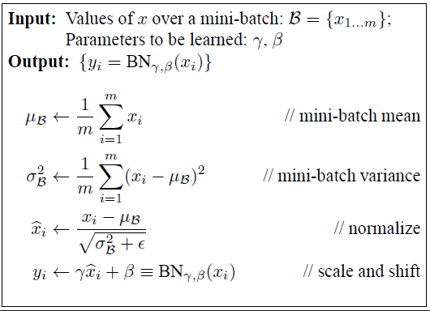
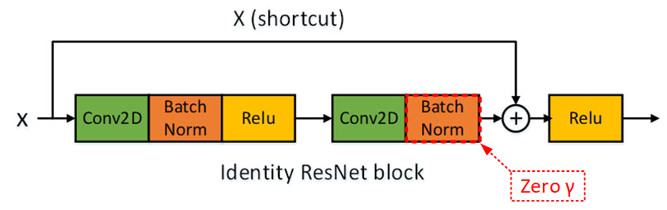
Zero gamma
γ and β: learnable parameters, initialized to 1 and 0 by default.
With zero γ, we initialize γ = 0 for all BN layers that sit at the end of a residual block.
Goyal et.al., “Accurate, Large Minibatch SGD: Training ImageNet in 1 Hour”
https://arxiv.org/pdf/1706.02677.pdf
Notes:
Zero Y: ResNets are composed of multiple Residual blocks. These can be denoted for simplicity as x+ block(x) These are usually followed by a batch normalization layers which are further scale transformed as Y*(x)+bias. (Y and bias are “learned” as we train the network) The paper suggests initializing for the layers at the end of ResNet blocks, Y should be initialized to 0. This reduces the number of learnable parameters initially.
γ and β: learnable parameters, initialized to 1 and 0 by default.
With zero γ, we initialize γ = 0 for all BN layers that sit at the end of a residual block.
Therefore, all residual blocks just return their inputs, mimics network that has less number of layers and is easier to train at the initial stage.

Slide 14
No bias decay
L2 regularization: to all parameters, often.
No bias decay
only apply the regularization to weights
Not for biases, γ and β in BN layers.
Jia et.al., “Highly Scalable Deep Learning Training System with Mixed-Precision: Training ImageNet in Four Minutes”
https://arxiv.org/pdf/1807.11205.pdf
Notes:
No Bias Decay: Regularisation is generally applied to all learnable parameters however, this often leads to overfitting. The authors suggest applying Regularisation just to the convolutional and fully connected layers, Biases and batch-norm parameters are not regularised.

Slide 15
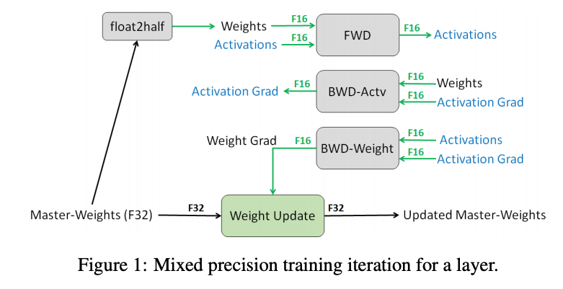
3.2 Low-precision Training
Weights, activations, gradients: FP16
Master weights updated during optimizer step: FP32
Micikevicius et.al., “Mixed Precision Training”
https://arxiv.org/pdf/1710.03740.pdf
Notes:
일반적으로 Neural Network는 32-bit floating point(FP32) precision을 이용하여 학습이 진행됩니다. 하지만 최신 하드웨어에서는 lower precision 계산이 지원되면서 속도에서 큰 이점을 얻을 수 있습니다. 예를 들자면, NVIDIA V100은 FP32 에서는 14TFLOPS일 때 FP16에서는 100 TFLOPS가 가능하며 전체적인 학습 속도도 FP32 대비 FP16에서 약 2~3배 빠르다고 합니다.
Mixed Precision Training: Mixed Precision training allows us to use Tensor Cores of the recent GPU(s) which are much faster, and thereby allow us to leverage fast FP16 operations and FP32 training for calculating weights or gradients, to allow “unsafe” operations to be done in Full Precision.
https://hackernoon.com/rtx-2080ti-vs-gtx-1080ti-fastai-mixed-precision-training-comparisons-on-cifar-100-761d8f615d7f

Slide 16
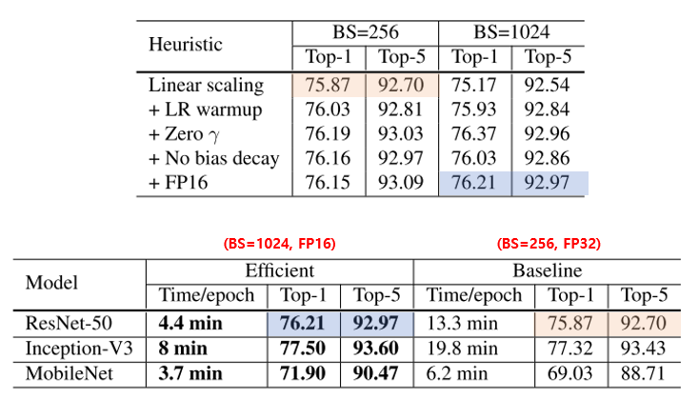
3.3 Experimental Results
pic: https://hoya012.github.io/blog/Bag-of-Tricks-for-Image-Classification-with-Convolutional-Neural-Networks-Review/
Notes:
Summing up with the efficient training techniques, we are able to speed up the training speed by up to 3 times while still being able to slightly improve the accruracies
아무런 방법도 적용하지 않았을 때의 ResNet-50의 실험 결과가 위의 그림의 주황색으로 음영을 넣은 부분 의 결과인 75.87%이며 각각의 heuristic을 하나씩 추가하였을 때의 결과가 나와있습니다. 모든 방식을 다 적용하였을 때의 결과는 파란색으로 음영을 넣은 부분 의 결과인 76.21% 입니다. Efficient Training에서는 약 0.3% 밖에 정확도가 오르지 않았지만 학습 속도가 약 3배 빨라지는 장점이 있었습니다.

Slide 17
4. Model Tweaks in GluonCV

Slide 18
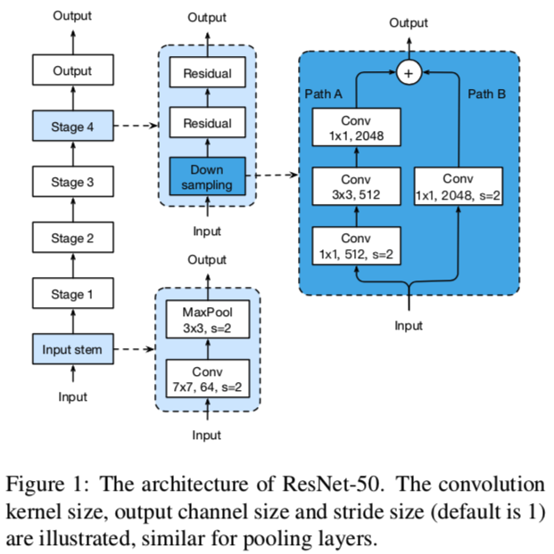
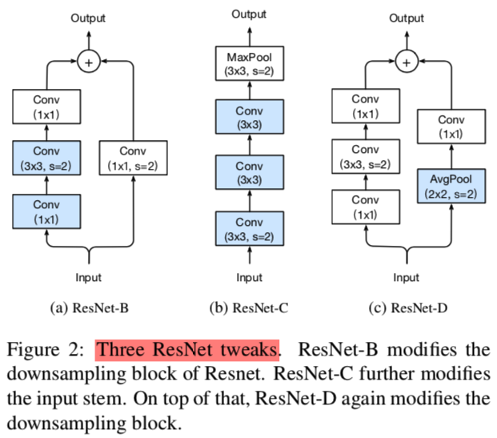
4. Model Tweaks
Minor Adjustment to the ResNet-50 Network
Proposed
Notes:
There are multiple variants of resnet models. …
◎ 4-1. ResNet Tweaks : ResNet-B
- Torch 버전으로 처음 등장했으며, 다양한 곳에서 ResNet 구현체로 사용되고 있음 (e.g. TF Official ResNet)
- Down Sampling Block (Bottle Neck)이 변경 되었음
- Baseline(ResNet-A)의 Path A에서는 정보 손실량이 많은데, Stride가 2인 1x1 Conv를 사용했기 때문
- ResNet-B는 3x3 Conv에서 Stride를 2로 줘서 Width, Height를 줄이고, 1x1 Conv는 정말 Channel Size만 변경하는 용도로 사용
◎ 4-1. ResNet Tweaks : ResNet-C
- Inception-V2 에서 5x5 Conv와 3x3 Conv 레이어를 두 번 거치는 것이 동일한 Receptive Field를 가지지만 후자가 Computation이 적기 때문 에 작은 사이즈의 Kernel을 여러 번 사용하는 것이 좋다고 설명한 것에서 영감을 얻어서 ResNet의 7x7 Stem 영역을 수정한 모델
- 이미 SENet, PSPNet, DeepLab-V3, ShuffleNet-V2 등에서 사용 중인 Tweak임
- Stem영역의 7x7 Conv를 여러 개의 3x3 Conv로 분리함. 7x7=49 vs 3x3x3=27으로 훨씬 적은 Computation만으로 기존과 동일하게 출력할 수 있음 (64 Channel + 4배 작은 Input Image)
◎ 4-1. ResNet Tweaks : ResNet-D - PROPOSED
- ResNet-B에서 영감을 얻은 Tweak으로 Path B의 정보 손실량을 최소화하기 위해 도입함
- Path B의 1x1 Conv가 Stride를 2로 설정하여 정보의 3⁄4가 유실됨.
- 실험을 통해 앞에 Stride가 2인 2x2 Average Pooling 레이어를 추가하고 1x1 Conv는 Stride를 1로 변경 - 약간의 연산량만 증가하고 더 좋은 결과가 얻어지는 것이 확인됨

Slide 19
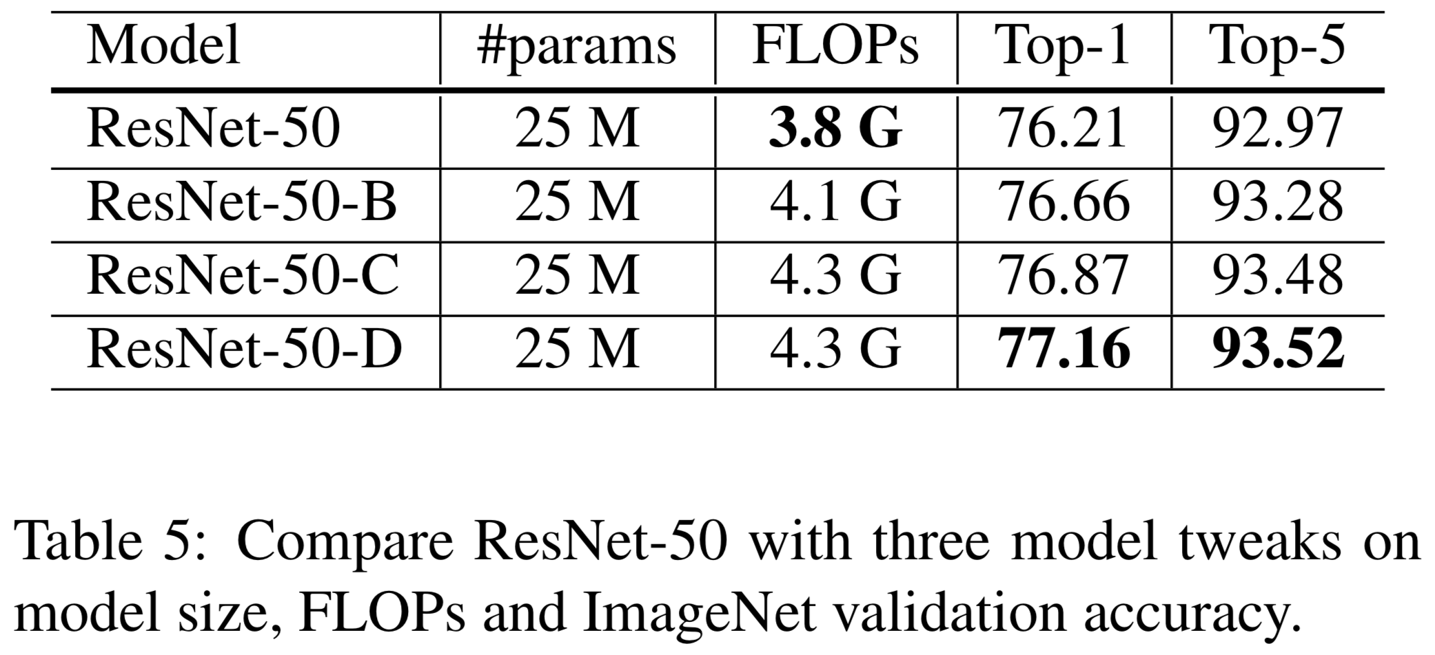
4.3 Experimental Results
Notes:
이번 파트에서는 ResNet architecture에 약간의 모듈들을 수정하여 성능을 올리는 방법을 제안하고 있습니다.
우선 Baseline으로 삼은 ResNet-50의 architecture는 아래 그림과 같이 나타낼 수 있습니다.
[ResNet-50 Architecture]이 그림에서 파란색으로 색칠된 영역인 Input stem에 변화를 준 ResNet-C 와 Stage 4의 Down sampling block 의 구조를 변경한 ResNet-B , ResNet-D 를 제안하였습니다.
각각의 Architecture에서 바뀐 block 구조와 그에 따른 정확도 변화는 아래 그림에서 확인할 수 있습니다.
[ResNet-B, C, D Architecture 및 실험 결과]ResNet-D에서 가장 정확도가 좋았으며,
약간의 FLOPS가 증가하였지만 Top-1 Accuracy가 거의 1% 증가하는 것을 확인할 수 있습니다.

Slide 20
5. Training Refinements in GluonCV

Slide 21
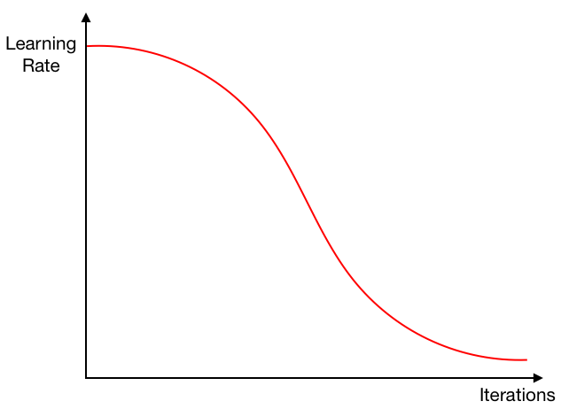
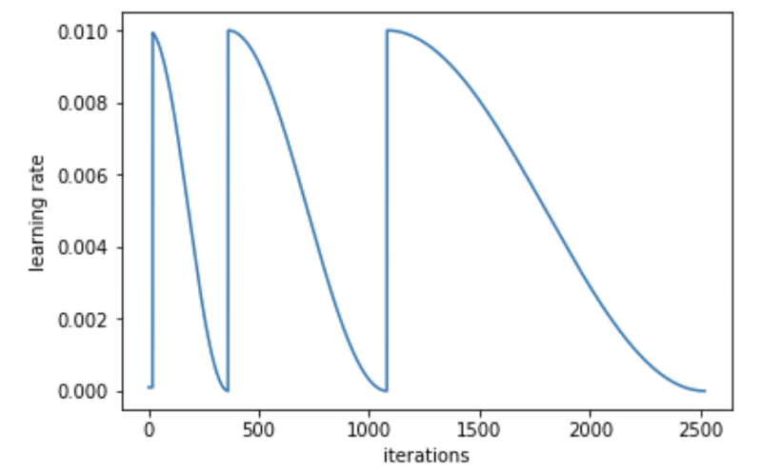
5.1 Cosine Learning Rate Decay
cosine annealing
SGDR: Stochastic Gradient Descent with Warm Restarts
https://arxiv.org/abs/1608.03983
pic: https://towardsdatascience.com/https-medium-com-reina-wang-tw-stochastic-gradient-descent-with-restarts-5f511975163
Notes:
1. SGDR uses cosine annealing, which decreases learning rate in the form of half a cosine curve, like the left figure.
This is a good method because we can start out with relatively high learning rates for several iterations in the beginning
to quickly approach a local minimum, then gradually decrease the learning rate as we get closer to the minimum, ending with several small learning rate iterations.
2. In order to find a more stable local minimum, we can increase the learning rate from time to time,
encouraging the model to “jump” from one local minimum to another if it is in a steep trough. This is the “restarts” in SGDR.

Slide 22
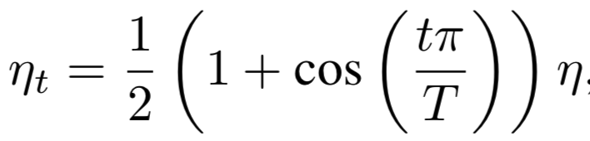
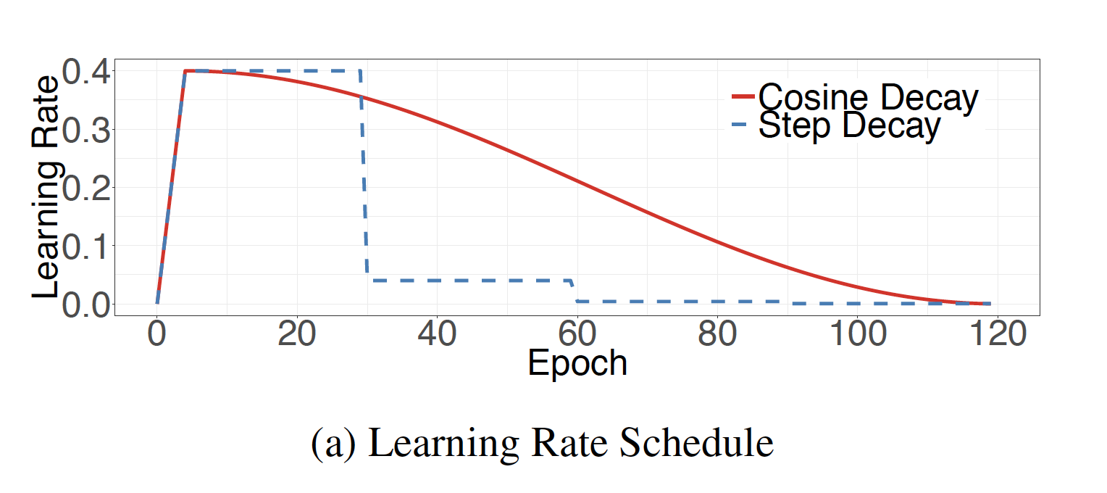
5.1 Cosine Learning Rate Decay
Notes:
◎ Cosine Decay (Cosine Annealing)
본 논문에서는 Restart는 사용하지 않고 처음부터 끝까지 천천히 Cosine 그래프를 따라 Learning Rate를 감소시키는 방식을 사용하였고 이를 적용 하여 성능이 증가하였음. Step Decay의 경우 Epoch에 맞춰서 사람이 지정해야 하는데, 어느 정도 Epoch에 어느 정도의 Learning Rate를 가지게 할지 경험적으로 평가하여 적용할 수 밖에 없음. 그에 비해 Cosine Decay는 Epoch에 맞게 적절한 Learning Rate를 지정해주기 때문에 높은 Accuracy를 얻을 수 있음
Typically, after the learning rate warm-up described earlier, we decrease the learning rate as the training progresses (the intuition being that as you get closer to the optimum, high learning rates might move you away from it). A smooth function to describe this schedule is the cosine function which we can see above.

Slide 23
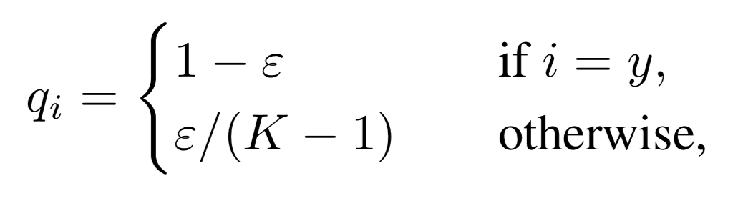
5.2 Label Smoothing
One hot: (0, 1, 0, 0, 0)
Smoothed: (0.01, 0.96, 0.01, 0.01, 0.01)
Prevent overfitting!
Rethinking the Inception Architecture for Computer Vision
https://arxiv.org/abs/1512.00567
Notes:
◎ Optimal Solution은 다른 값들이 충분히 작을 때 = inf가 되는 것인데, 학습을 진행하면 이 방향으로 흘러가서 결국 과적합으로 이어질 가능 성이 있다고 주장. 즉, 출력된 클래스 간의 차이가 커야 정답으로 인정하게 되는 것인데, 이렇게 학습되면 모델이 해당 클래스가 정답일 것이라고 너무 확신하게 설계된다는 문제가 있음
◎ Inception V2를 학습시키기 위해 제안된 Label Smoothing은 True Probability를 아래와 같이 바꾸는 것
◎ Smoothed Label의 Logit을 구하면 다음과 같음. 만약 epsilon이 0이면 정답과 오답 사이의 Logit 무한대로 수렴하고, epsilon을 높이면 정답과 오답 사이의 Logit이 줄어듦. Empirical하게 실험해본 결과 K=1000 (ImageNet), epsilon=0.1 인 경우, Logit간의 Gap이 9.1정도로 수렴하는 것을 확인하였음. 이는 모델을 Generalize 하는 효과를 가지고, 실제로 분류 성능이 향상되었음
If the loss is cross-entropy, for mathematical reasons, the network has an incentive to make the prediction for one category very large and the others very small and this leads to over-fitting.
Label Smoothing: This suggests tweaking the final the final layers and the probability distribution for the predictions to allow the network to generalize better.

Slide 24
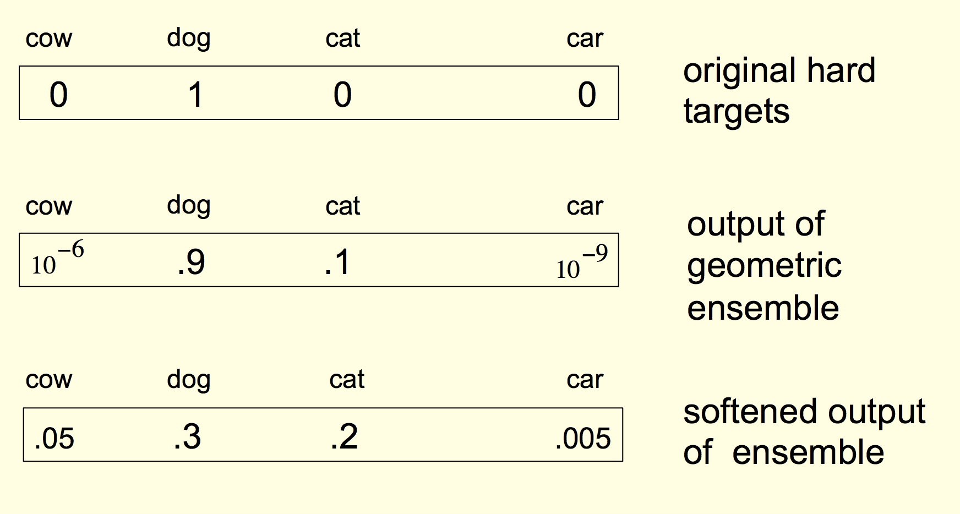
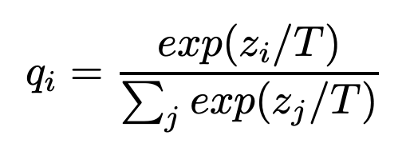
5.3 Knowledge Distillation
T = temperature
Higher T, softer class distribution
Distilling the Knowledge in a Neural Network
https://arxiv.org/abs/1503.02531
Notes:
◎ 이미 학습된 기존의 거대한 Teacher Neural Network(ResNet-152)가 가지고 있는 Knowledge를 또 다른 작은 Student Neural Network(ResNet-50)에 효율적으로 전달할 수 있는 Knowledge Distillation 기법을 연구
◎ Softmax는 이러한 Knowledge를 보유하고 있음. 고양이와 비슷하게 생긴 강아지를 보고 고양이일 가능성이 10%는 있다는 Knowledge를 내포
◎ Loss Function (z=student, r=teacher, T=hyper parameter, T는 출력을 더욱 Soft하게 바꿈)
기존의 정답(p)와 예측(softmax(z))의 Loss 뿐만 아니라, Teacher(ResNet-152의 예측)과 Student(ResNet-50의 예측)의 Loss Term을 추가함
Distilling the knowledge in a neural network 논문에서 제안한 방법인 Knowledge Distillation 또한 잘 알려진 방법이며 성능이 좋은 teacher model을 이용하여 student model이 적은 연산 복잡도를 가지면서 teacher model의 정확도를 따라가도록 학습을 시키는 방법을 의미합니다.
Teacher model로 ResNet-50보다 큰 모델인 ResNet-152를 사용하였고, 이를 이용하여 student model인 ResNet-50을 학습시켰습니다.
Knowledge Distillation: This approach “Distills” the knowledge from another pre-trained “teacher” model into our current student network. This is done by adding a distillation loss that penalizes our student network based on how much its predictions are off when compared to the “teacher model”.
Knowledge distillation entails adding a term to the loss function
which accounts for the difference between the student model and the teacher model
to ensure that the student model does not differ too much from the teacher model.
Loss with knowledge distillation. T is the temperature hyperparameter, r is the teacher output, z is the student output and p is the target.

Slide 25
5.3 Knowledge Distillation
Distilling the Knowledge in a Neural Network
https://arxiv.org/abs/1503.02531
Notes:
◎ 이미 학습된 기존의 거대한 Teacher Neural Network(ResNet-152)가 가지고 있는 Knowledge를 또 다른 작은 Student Neural Network(ResNet-50)에 효율적으로 전달할 수 있는 Knowledge Distillation 기법을 연구
◎ Softmax는 이러한 Knowledge를 보유하고 있음. 고양이와 비슷하게 생긴 강아지를 보고 고양이일 가능성이 10%는 있다는 Knowledge를 내포
◎ Loss Function (z=student, r=teacher, T=hyper parameter, T는 출력을 더욱 Soft하게 바꿈)
기존의 정답(p)와 예측(softmax(z))의 Loss 뿐만 아니라, Teacher(ResNet-152의 예측)과 Student(ResNet-50의 예측)의 Loss Term을 추가함
Knowledge distillation entails adding a term to the loss function
which accounts for the difference between the student model and the teacher model
to ensure that the student model does not differ too much from the teacher model.
Loss with knowledge distillation. T is the temperature hyperparameter, r is the teacher output, z is the student output and p is the target.
This approach “Distills” the knowledge from another pre-trained “teacher” model into our current student network. This is done by adding a distillation loss that penalizes our student network based on how much its predictions are off when compared to the “teacher model”.

Slide 26
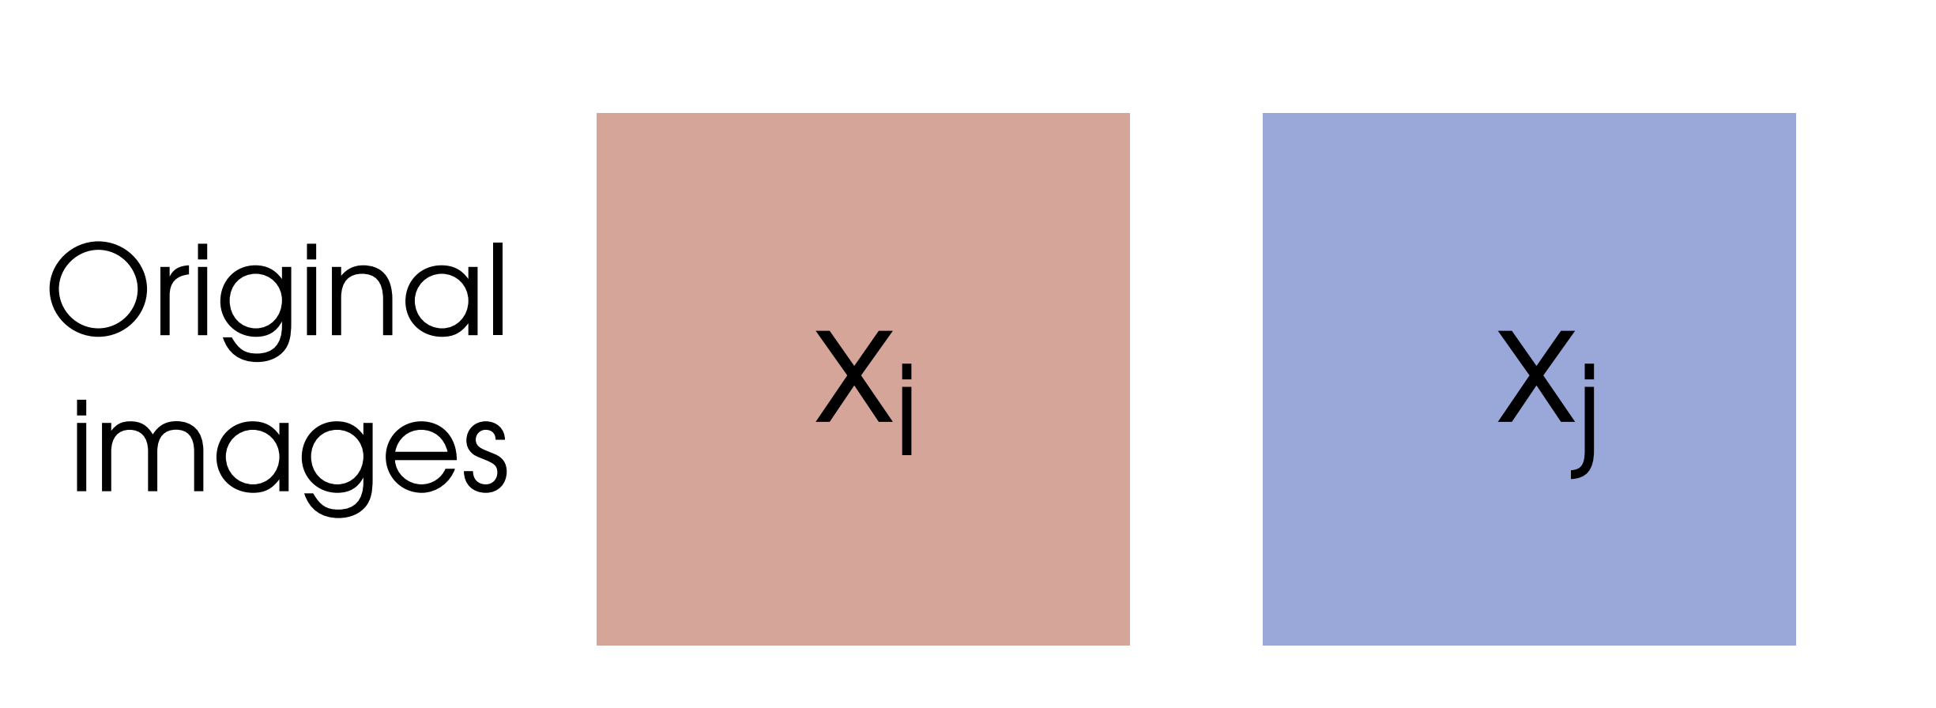

5.4 Mix-Up
Linear mapping
𝑓(𝑎𝑥_𝑖+𝑏𝑥_𝑗 )=𝑎𝑓(𝑥_𝑖 )+𝑏𝑓(𝑥_𝑗)
mixup: Beyond Empirical Risk Minimization
https://arxiv.org/abs/1710.09412
Notes:
Mixup means linearly interpolating two training examples and creating a new one.
마지막으로 소개드릴 Mixup augmentation은
Data에 dependent한 augmentation 기법이며
두 데이터의 이미지와 label을 각각 weighted linear interpolation 하여 새로운 sample을 생성하는 기법을 의미합니다.
◎ Data Augmentation 기법으로 두 이미지와 Label을 각각 Weighted Linear Interpolation 하여 새로운 이미지 데이터를 만들어 내는 기법
λ ∈ [0, 1]는 Beta 분포에서 랜덤으로 뽑혀져 나온 상수이고 이렇게 만들어진 Image를 Training에 활용함

Slide 27
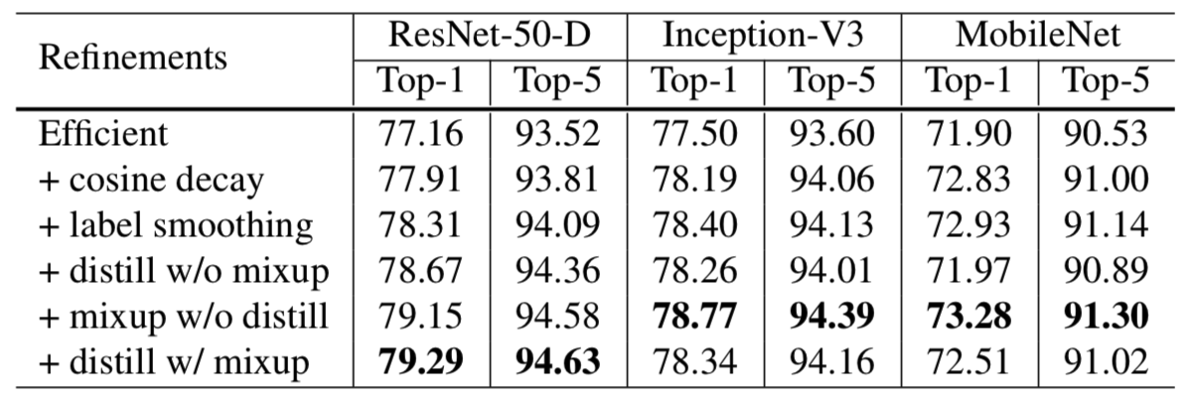
5.5 Experimental Results
Table 6: The validation accuracies on ImageNet for stacking training refinements one by one.
Notes:
Training Refinement 실험 결과
위에서 설명 드린 4가지 방법을 적용하였을 때 실험 결과는 다음과 같습니다.
[Training Refinement 실험 결과]
앞선 방법들(Efficient Training, Model Tweaks)이 적용된 결과에
위에서 설명 드린 4가지 방법을 차례대로 적용하였을 때 정확도가 얼마나 향상되는지 표를 통해 확인할 수 있습니다.
각 방법을 적용하면 적게는 0.4%에서 많게는 0.7%까지 정확도가 향상되는 것을 확인할 수 있습니다.

Slide 28
6. Transfer Learning
Notes:
Let’s take a look at how the proposed methods generalize in other tasks, which is very important.

Slide 29
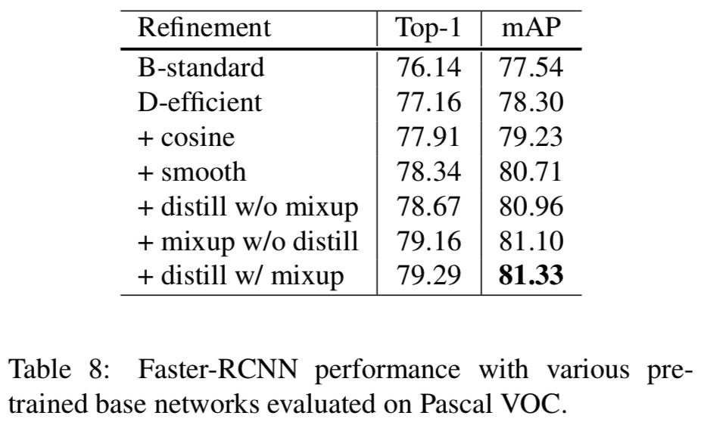
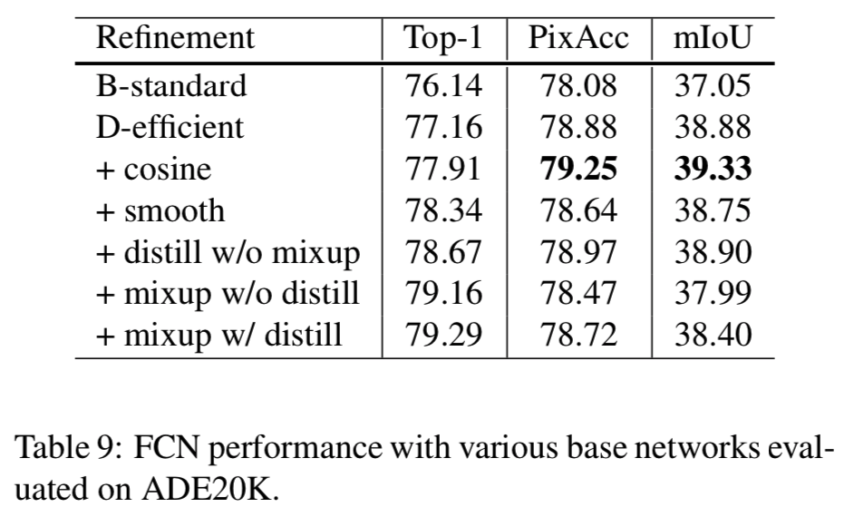
6. Transfer Learning
Object Detection
Semantic Segmentation
Notes:
이번 파트에서는 앞서 찾은 Classification 모델에 적용하였던 여러 방법들을
다른 task인 Object Detection, Semantic Segmentation에 적용하였을 때에도 성능이 좋아지는지 확인하기 위한 실험을 수행하였습니다.
우선 Object Detection은 VGG-19를 base로 하는 Faster-RCNN에 대해 실험을 진행하였고,
Semantic Segmentation은 Fully Convolutional Network(FCN)에 대해 실험을 수행하였습니다.
실험 결과는 위의 표에 나와있으며 적용하기 전에 비해 성능이 대체로 향상되는 것을 확인할 수 있습니다.
다만 Semantic Segmentation의 경우 label smoothing, mixup 등은 오히려 안 좋은 효과를 내었습니다.

Slide 30
7. Conclusion

Slide 31
7. Conclusion
Surveyed tricks to train CNNs to improve model accuracy
Tricks: Minor modifications to the model architecture, data preprocessing, loss function, and learning rate schedule
Empirical results on ResNet-50, Inception-V3 and MobileNet: model accuracy improved consistently
Stacking all of them together leads to a significantly higher accuracy
Strong advantages in transfer learning: both object detection and semantic segmentation improved
Notes:
This is one of the first papers to embrace the little tricks that are usually not in the spotlight or not given as much importance in papers.
The paper does a deep-dive into all of the ideas, showing extensive comparisons.
이번 포스팅에서는 CVPR 2019에 발표된 논문인 “Bag of Tricks for Image Classification with Convolutional Neural Networks” 논문을 리뷰해보았습니다.
굉장히 실험적인 논문이며 인용한 논문이 굉장히 많았고, 이들에 대해 모든 실험을 통해 성능을 올릴 수 있음을 보여주고 있다는 점이 인상깊었습니다.
앞으로 Image Classification 학습에 관여하는 여러 요소들을 고려할 때 이 논문을 참고하면 좋을 것 같네요!
In this paper, we survey a dozen tricks to train deep convolutional neural networks to improve model accuracy.
These tricks introduce minor modifications to the model architecture, data preprocessing, loss function, and learning rate schedule.
Our empirical results on ResNet-50, Inception-V3 and MobileNet indicate that these tricks improve model accuracy consistently.
More excitingly, stacking all of them together leads to a significantly higher accuracy.
In addition, these improved pre-trained models show strong advantages in transfer learning,
which improve both object detection and semantic segmentation.
We believe the benefits can extend to broader domains where classification base models are favored.

Slide 32
Hands On!

Slide 33

Like GluonCV? Go build!
https://github.com/dmlc/gluon-cv
https://gluon-cv.mxnet.io

